Slide 2
Digital Forensics Lecture-27
By- Dr.subhranil Das
Assistant Professor
School of computer Science

Slide 3

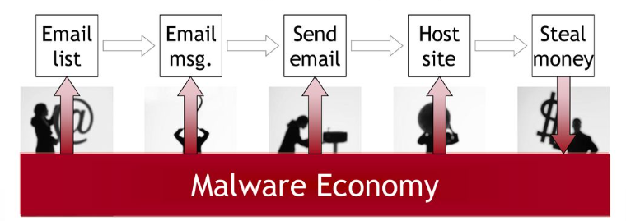
Behavioral Analysis

Slide 4
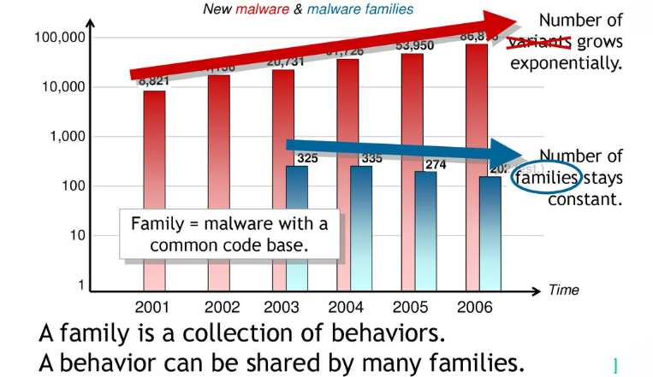
Behavioral Analysis

Slide 5
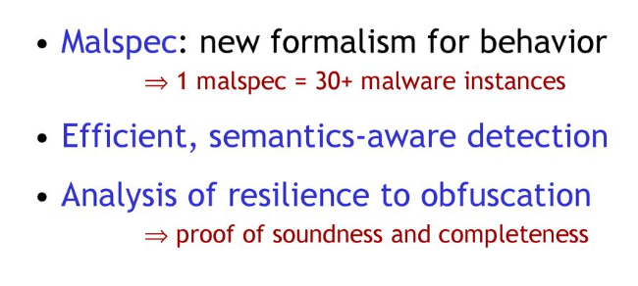
Malspec

Slide 6
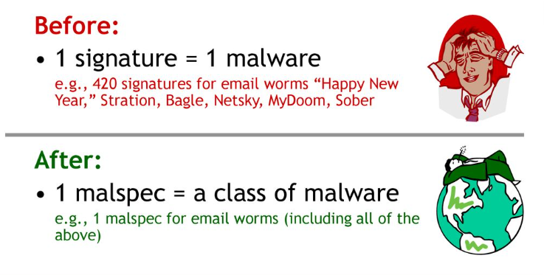
Malspec

Slide 7
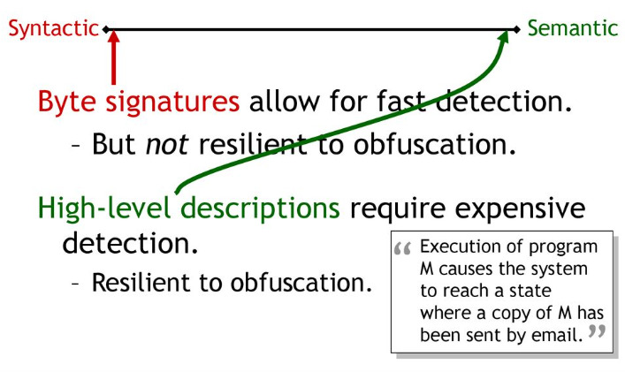
Specifying Behaviour

Slide 8
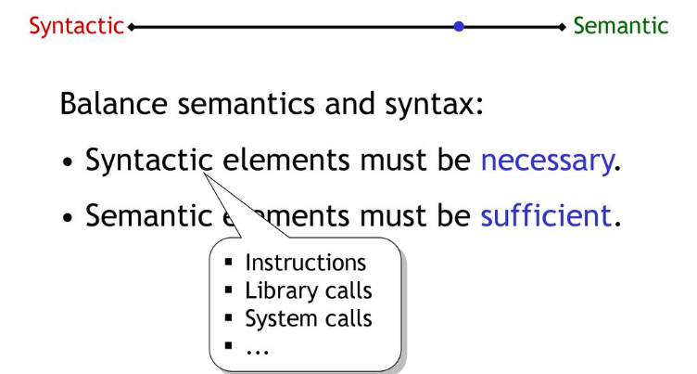
Malicious Behavior Detection

Slide 9
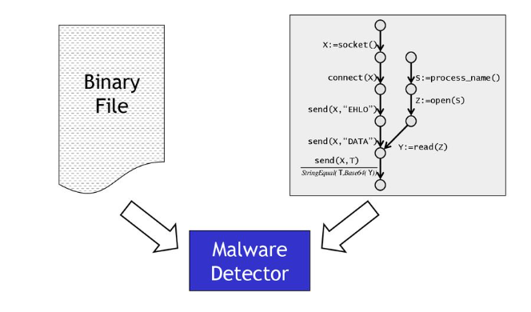
Detection of Malicious Behaviour

Slide 10
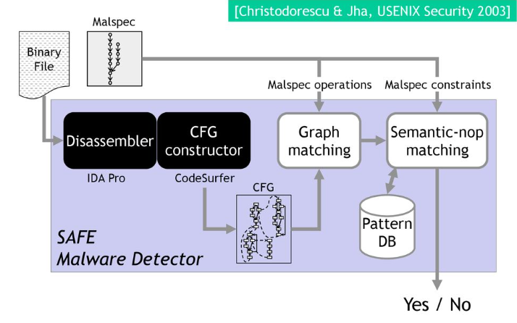
Detection of Malicious Behaviour

Slide 11
Next Lecture
Network Forensics
.

Slide 12
Quiz 3 (any one)
1. How can memory forensics be utilized to extract and analyze volatile memory data, and why is this important in digital investigations?
2. What techniques and tools are commonly used to analyze and interpret digital evidence, especially in the context of file system forensics?

